Slide 1

Vel Tech Rangarajan Dr. Sagunthala R&D Institute of Science and Technology
School of Computing
Department of Computer Science and Engineering
10211CS224 / FULL STACK APPLICATION DEVELOPMENT (JAVA)
END SEMESTER PROJECT REVIEW
Date: 06-05-2026
Design and develop a React JS based web application for Ticket Booking of an Internal Department Event
SDG:SDG 4 – Quality Education
Presented By:
V.Rambabu– VTU25536 – 23UECS1236
Courses Handling Faculty:
Dr. Hafizur Rahman, Assistant Professor

Slide 2
INTRODUCTION
The rapid growth of digital technologies has transformed the way events are organized and managed.
Traditional ticket booking methods for internal department events—such as technical fests, seminars, and workshops—often involve manual registration, which can lead to inefficiencies like data errors, overbooking, and lack of real-time updates.
To address these challenges, a web-based ticket booking system using React JS is proposed.
This application provides an interactive and user-friendly platform where students and faculty can easily view event details and book tickets online.
By leveraging modern frontend technologies, the system ensures efficient ticket management, real-time updates, and improved user experience.
1
2
3
4
5
6
7
8
9

Slide 3
PROBLEM STATEMENT
Manual or semi-digital ticket booking systems used for internal department events face several limitations:
Lack of real-time tracking of available tickets
Possibility of overbooking due to manual errors
Inefficient data handling and record maintenance
Poor user experience due to non-interactive interfaces
Difficulty in validating user inputs (e.g., email format, ticket count)
Time-consuming booking and confirmation process
1
2
3
4
5
6
7
8
9

Slide 4
OBJECTIVE(S)
The main objectives of this project are:
To develop a React JS-based web application for internal event ticket booking.
To display complete event details such as name, department, date, time, venue, ticket price, and availability.
To allow users to book tickets by entering required details.
To implement input validation for accurate and secure data entry.
To prevent overbooking by restricting ticket count based on availability.
To dynamically update the available number of tickets after each booking.
1
2
3
4
5
6
7
8
9

Slide 5
PROPOSED SYSTEM
The proposed system is a React-based web application with the following features:
Event Details Module:
Displays event name
Shows department organizing the event
Provides date and time information
2. Ticket Booking Module
Validates user inputs before submission
Prevents booking more tickets than available
Displays confirmation message upon successful booking.
1
2
3
4
5
6
7
8
9

Slide 6
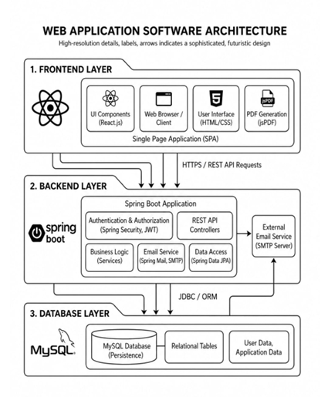
PROPOSED SYSTEM ARCHITECTURE
Input: The input stage involves all the data provided by users and administrators. Users enter details such as registration information (name, email, phone number), login credentials, event selection, seat preferences, and payment details.
Processing: In this stage, the system handles and validates the input data. When a user logs in, the system verifies credentials.
Database: The database acts as the central storage unit of the application. It stores user information, login credentials, event details, seat availability, booking records, and transaction history.
Output: The output stage presents the results of processing to the users and admin. For users, this includes displaying available events, booking confirmations, digital tickets with QR codes, and payment status messages.
1
2
3
4
5
6
7
8
9
System Architecture

Slide 7
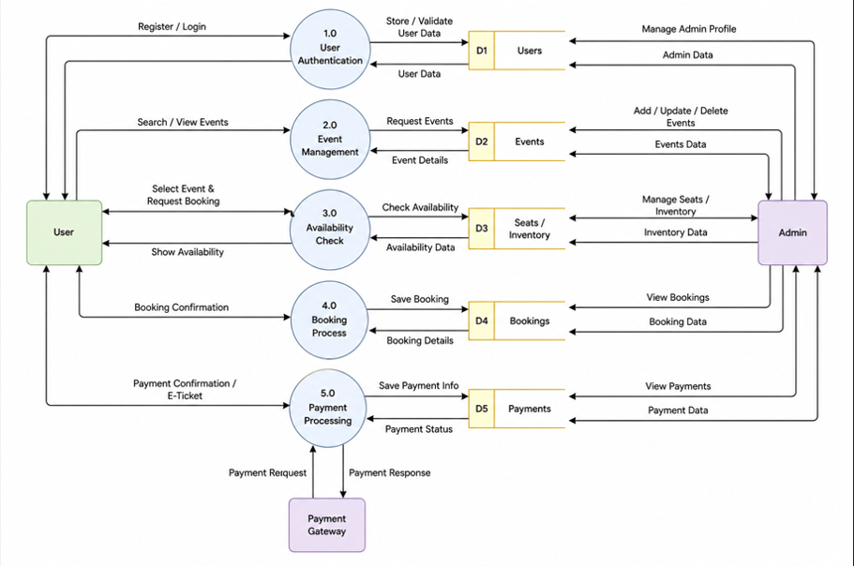
WORKFLOW
The Admin Login page in the Ticket Booking Web Application for Technical Fest acts as the secure entry point for the system administrator.
It is designed with a clean and modern interface, divided into two main sections to improve usability and visual appeal.
1
2
3
4
5
6
7
8
9
DataFlow Diagram

Slide 8
TECHNOLOGIES USED
1
2
Frontend: React JS, HTML, CSS, JavaScript (for designing interactive user interface).
IDE/Tools: Visual Studio Code / IntelliJ IDEA / Eclipse for development.
Package Manager: Node.js & npm (for installing dependencies and running the application).
Server: React Development Server (localhost) for running the application in browser.
3
4
5
6
7
8
9

Slide 9
MODULE DESCRIPTION
1
2
Event Details Module: Displays all information related to the event.
Ticket Booking Module:Provides a form for users to book tickets and handles form submission and processes booking.
Validation Module:Ensures correctness of user inputs and displays error messages for invalid inputs.
Booking Confirmation Module:Displays success message after booking and improves user satisfaction with clear feedback.
Ticket Management Module:Updates ticket count after each successful booking
3
4
5
6
7
8
9

Slide 10
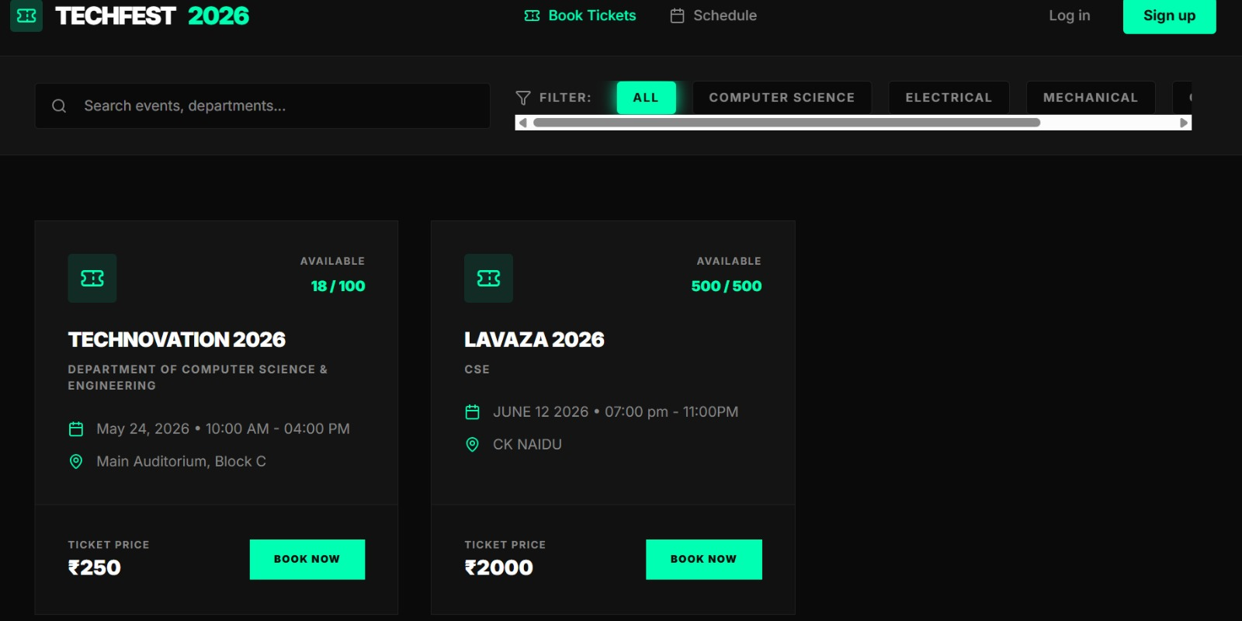
IMPLEMENTATION SCREENSHOTS
1
The Home Page of the Ticket Booking Web Application for Technical Fest is the main entry point for users and provides an overview of the entire system.
It is designed to be visually appealing, simple, and easy to navigate so that users can quickly understand and access different features.
2
3
4
5
6
7
8
9
Home Page

Slide 11
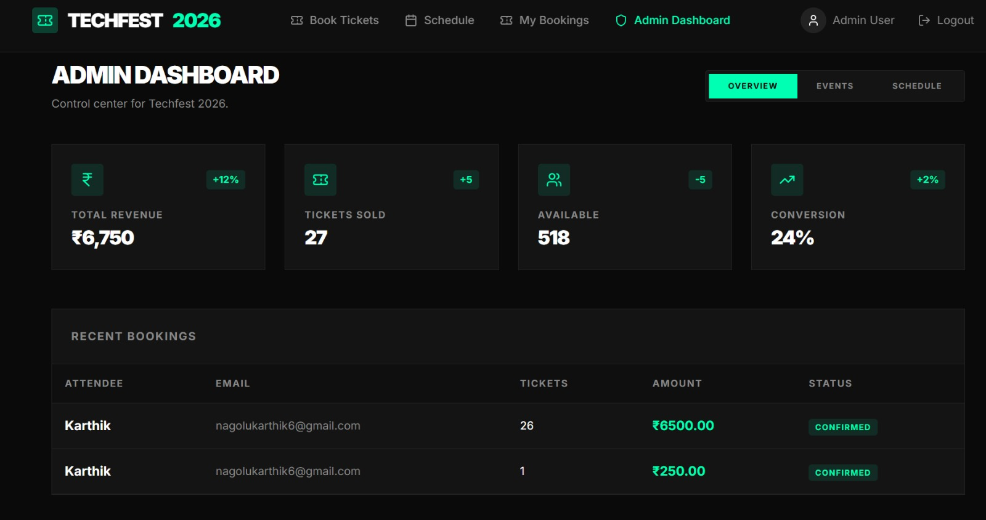
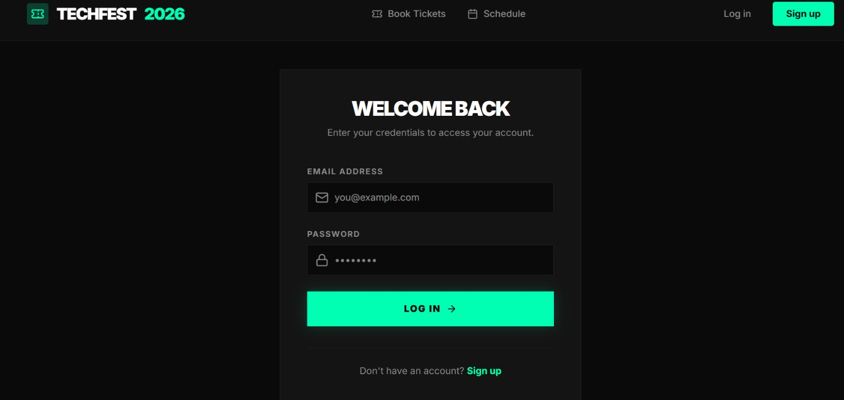
IMPLEMENTATION SCREENSHOTS
1
2
3
4
5
6
7
8(A)
9
Admin Page
Login Page

Slide 12
IMPLEMENTATION SCREENSHOTS
The Home Page of the Ticket Booking Web Application for Technical Fest is the main entry point for users and provides an overview of the entire system.
It is designed to be visually appealing, simple, and easy to navigate so that users can quickly understand and access different features.
Module 1 - Event Details

Slide 13
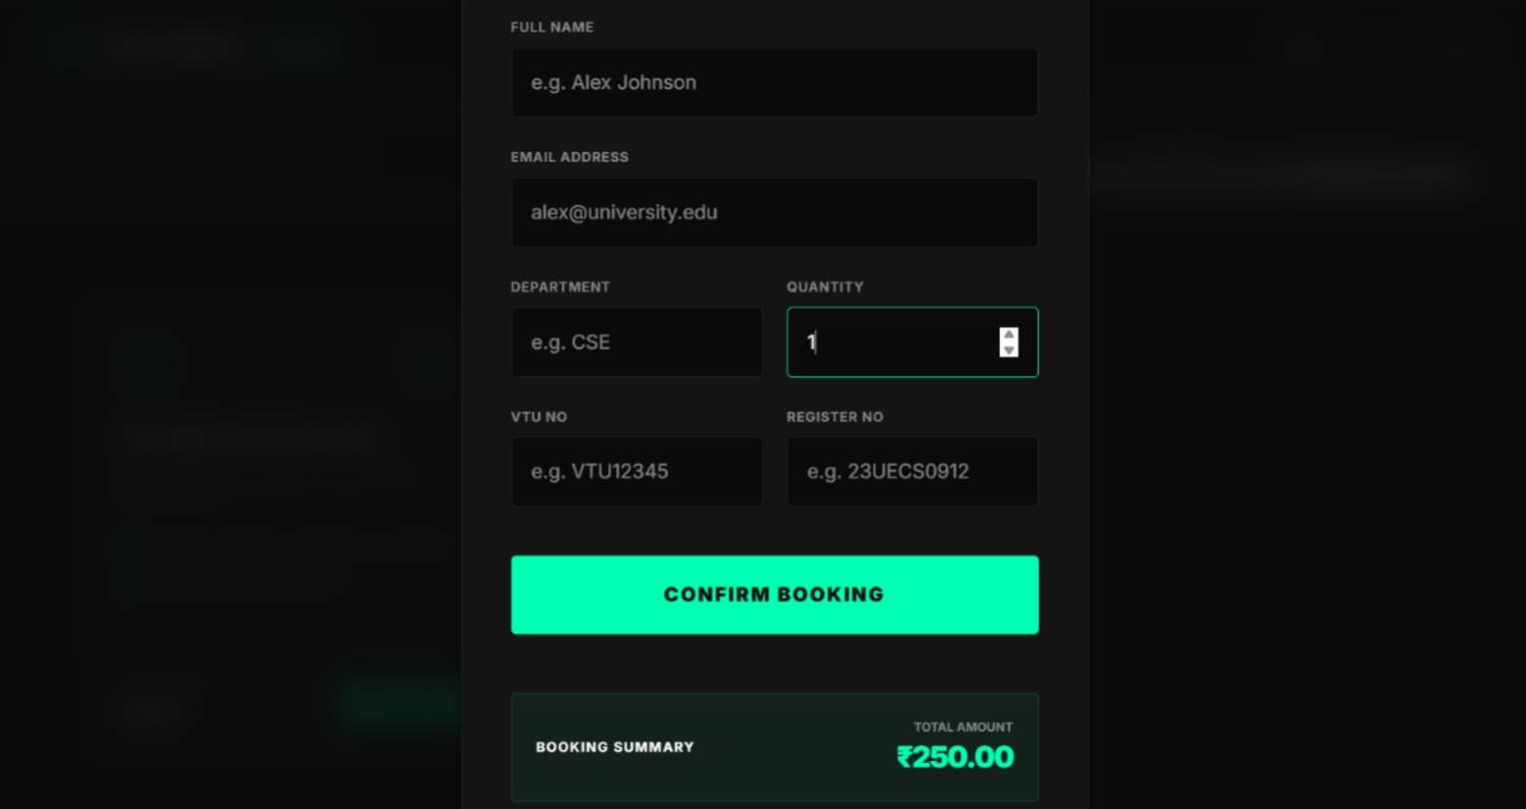
IMPLEMENTATION SCREENSHOTS
The Booking Page in the Ticket Booking Web Application for Technical Fest is where users select and confirm their tickets for a chosen event.
It is designed to be clear and interactive so users can complete the booking process without confusion.
Module 2 - Ticket Booking

Slide 14
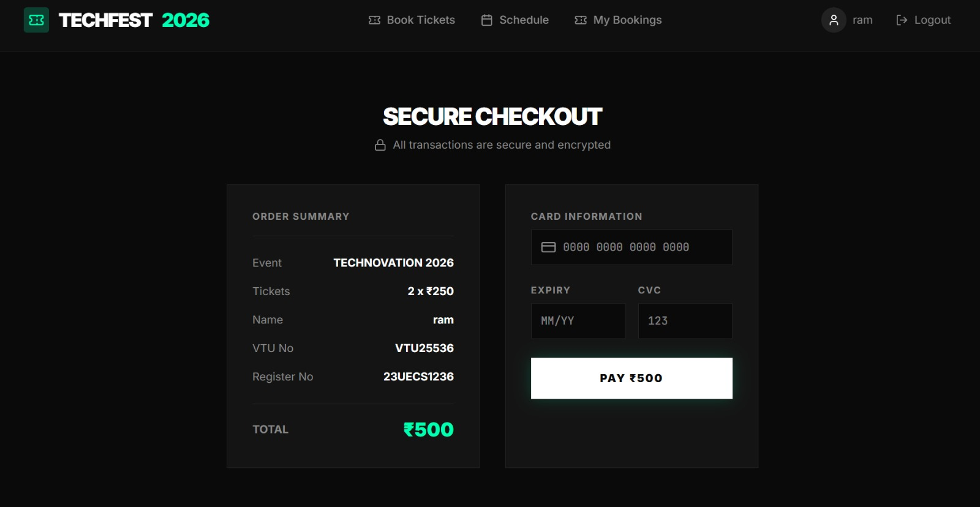
IMPLEMENTATION SCREENSHOTS
The Secure Checkout module is an innovative feature added to the Ticket Booking Web Application for Technical Fest to ensure safe, reliable, and fraud-free payment processing.
This module enhances user trust by protecting sensitive information and providing a smooth payment experience.
Innovative Module

Slide 15
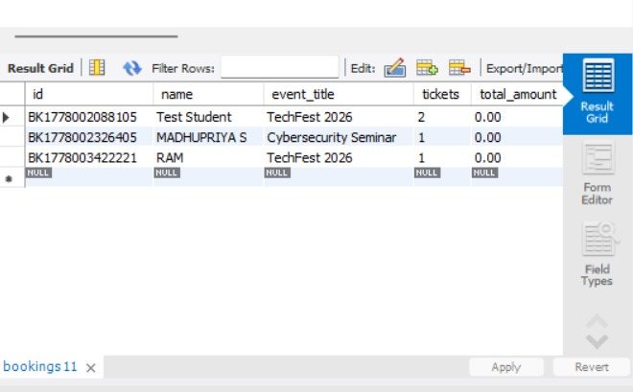
IMPLEMENTATION SCREENSHOTS
Database

Slide 16
ADVANTAGES & LIMITATIONS
1
Advantages:
Easy and quick ticket booking process.
Real-time update of ticket availability.
Prevents overbooking errors.
Efficient data handling using React state.
Reduces manual work and paperwork
Limitations:
No backend/database (data is not stored permanently).
Refreshing the page resets ticket data.
Limited to single event (can be extended for multiple events).
No authentication or user login system.
Cannot handle high traffic or concurrent users in current form.
2
3
4
5
6
7
8
9

Slide 17
Thank you

